Slide 1

Lecture 5
Truncation Errors

Slide 2
Introduction
So far we learned how to numerically integrate defined integrals
However, we do not yet know how to estimate the error of quadrature formulas
In this second part on numerical integration we will learn how to estimate these errors
Notes:
So far we learned how to numerically integrate defined integrals
However, we do not yet know how to estimate the error of quadrature formulas
In this second part on numerical integration we will learn how to estimate these errors

Slide 3
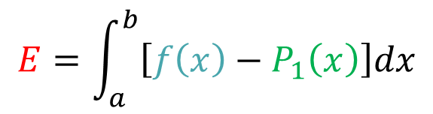
Errors of Quadrature Formulas
$$y$$
$$y=f(x)$$
$$y=P_{1}(x)$$
Error
$$I=\int_{a}^{b}{f(x)dx}$$
$$I≅\int_{a}^{b}{P_{1}(x)dx}$$
$$E=\int_{a}^{b}{\left[f\left(x\right)−P_{1}\left(x\right)\right]dx}$$
$$x$$
$$a=x_{o}$$
$$b=x_{1}$$
Notes:
The idea behind quadrature formulas is to use interpolating polynomials to approximate the function to integrate and afterward integrate this interpolating polynomial
The error is the difference between the defined integral of f and the defined integral of the interpolating polynomial

Slide 4
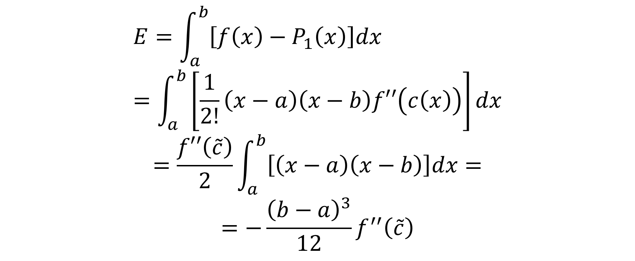
Error of Trapezoid Rule
$$E=\int_{a}^{b}{\left[f\left(x\right)−P_{1}\left(x\right)\right]dx}=\int_{a}^{b}{\left[\frac{1}{2!}\left(x−a\right)\left(x−b\right)f′′\left(c\left(x\right)\right)\right]dx}$$
$$=\frac{f′′\left(\tilde{c}\right)}{2}\int_{a}^{b}{\left[\left(x−a\right)\left(x−b\right)\right]dx}=$$
$$=−\frac{{\left(b−a\right)}^{3}}{12}f^{′′}\left(\tilde{c}\right)$$
Notes:
In the case of the trapezoid rule this error is the integral over the difference between f and P1(x)
From the lecture on interpolating functions, we know how to estimate the difference between a function and it’s interpolating polynomial
In the case of our linear interpolating polynomial this is $\frac{1}{2!}\left(x−a\right)\left(x−b\right)f′′\left(c\left(x\right)\right)$
Note that the number c is function of x
But using the mean value theorem, you learned in calculus, allows us to handle this situation and move the term $f′′\left(\tilde{c}\right)$ out of the integral
After calculating the integral we can get an expression for the truncation error which is $−\frac{{\left(b−a\right)}^{3}}{12}f^{′′}\left(\tilde{c}\right)$

Slide 5
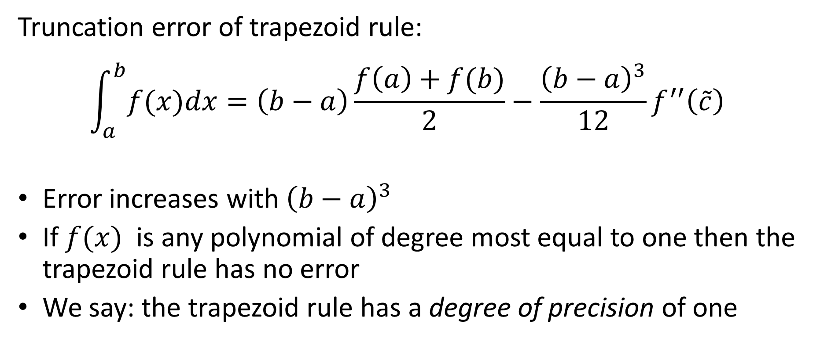
Error of Trapezoid Rule
Truncation error
Truncation error of trapezoid rule:
$$\int_{a}^{b}{f(x)dx}=\left(b−a\right)\frac{f\left(a\right)+f(b)}{2}−\frac{{\left(b−a\right)}^{3}}{12}f^{′′}\left(\tilde{c}\right)$$
Error increases with ${\left(b−a\right)}^{3}$
If $f(x)$ is any polynomial of degree most equal to one then the trapezoid rule has no error
We say: the trapezoid rule has a degree of precision of one
Notes:
We can now write down the trapezoid rule including the truncation error term
Let us add some remarks on this error term
First, we note that the error increases in power three with the length of the integration interval
That means that the larger the integration interval is, the larger will be the truncation error
This justifies why we want to use composite methods in order that the trapezoid rule will always be applied on small intervals
Second we can note that if f(x) is a polynomial of maximum degree one, then the truncation error will be zero. Indeed in such case f” will be always equal to zero
In the context of numerical integration, one says that the trapezoid rule has a degree of precision one

Slide 6
Degree of Precision
Definition
The degree of precision of a quadrature formula is the highest degree of a polynomial which will be integrated exactly with the quadrature formula
Notes:
The degree of precision of quadrature formula is defined as the highest degree of a polynomial which will be integrated exactly with the quadrature formula
The degree of precision is a common way to compare quadrature formulas in term of error.
The higher the degree of precision, the lower will be the truncation error

Slide 7
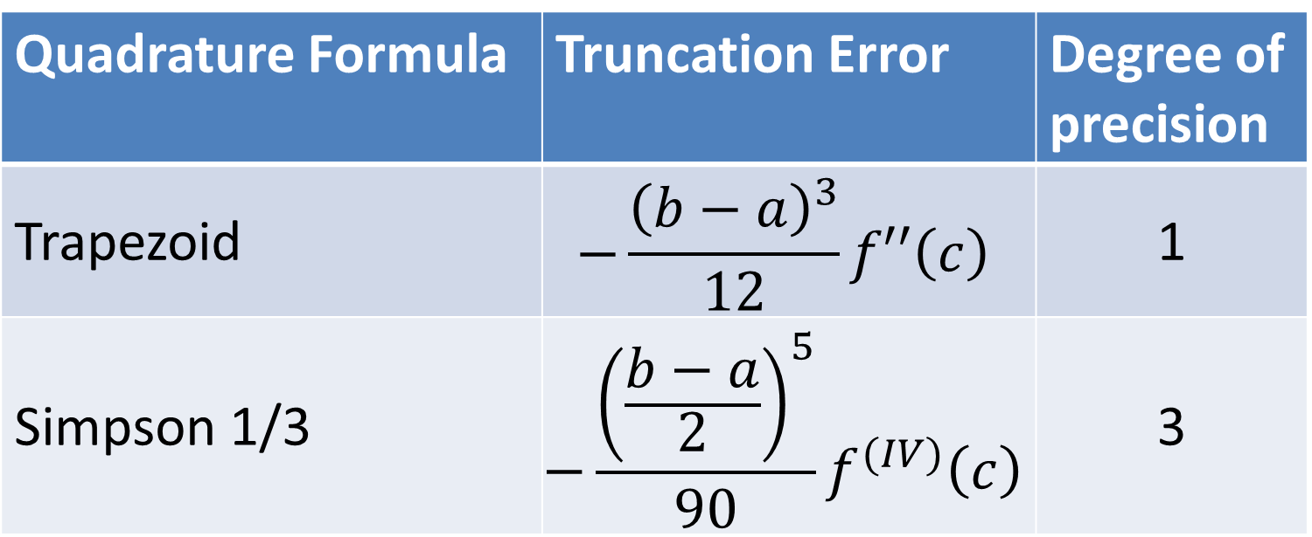
Errors of Quadrature Formulas
Quadrature Formula | Truncation Error | Degree of precision
Trapezoid | $$−\frac{{\left(b−a\right)}^{3}}{12}f′′\left(c\right)$$ | 1
Simpson 1/3 | $$−\frac{{\left(\frac{b−a}{2}\right)}^{5}}{90}f^{(IV)}\left(c\right)$$ | 3
Notes:
As we just saw, the degree of procession of the trapezoid rule is one
This is because the truncation error is proportional to the second derivative of f
For Simpson's 1/3 rule, the truncation error is proportional to the forth derivative of f
Consequently the degree of procession will be 3
Indeed any polynomial of maximal degree three will be integrated without any error by Simpson's 1/3 rule, as in such case the fourth derivative will be equal to zero
Let us recall that the number c that appears in these error formulas is some number within the integration interval
I recommend you to write down the error formulas on a piece of paper as we will shortly need them in an example

Slide 8

Example
Evaluate numerically
$$I=\int_{1}^{2}{ln⁡(x)dx}$$
Exact value:
$$I=\int_{1}^{2}{ln⁡(x)dx}=2\ln\left(2\right)−1ln⁡(1)≅0.3863$$
Notes:
Let us show with an example how we can use this error formulas
We use the defined integral of the natural log function from 1 to 2
As we know the exact value is about 0.3863
Let us now see if we can, based on our error formulas, predict the error we obtain when applying either the trapezoid or the Simpson 1/3 rule

Slide 9
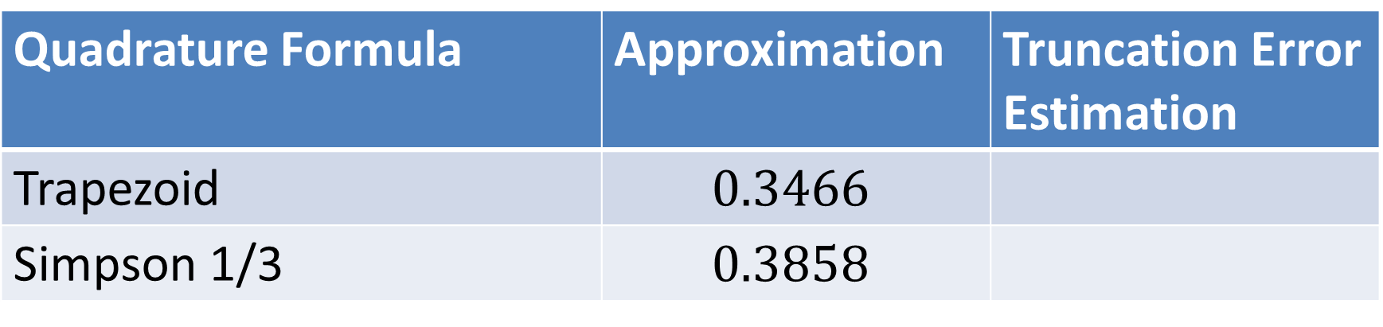
Example
Quadrature Formula | Approximation | Truncation Error Estimation
Trapezoid | $$0.3466$$
Simpson 1/3 | $$0.3858$$
Notes:
First we apply the two quadrature formulas
We did this in previous lectures. But you may wish as well to try as an exercise to reproduce it here

Slide 10
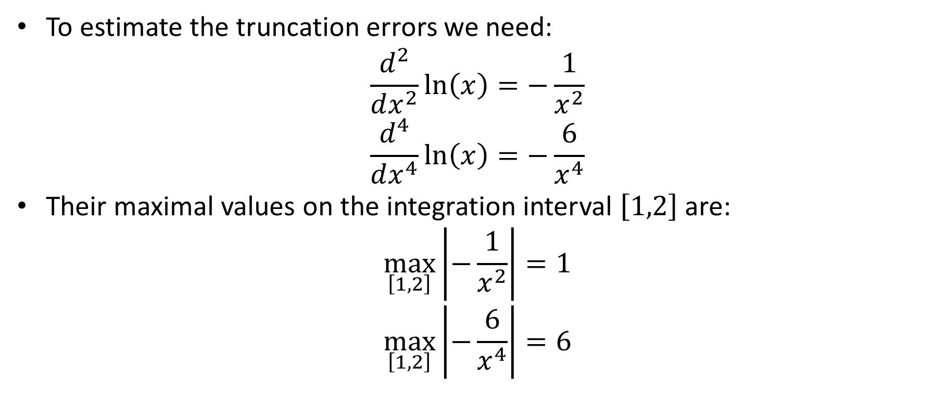
Example
To estimate the truncation errors we need:
$$\frac{d^{2}}{dx^{2}}\ln\left(x\right)=−\frac{1}{x^{2}}$$
$$\frac{d^{4}}{dx^{4}}\ln\left(x\right)=−\frac{6}{x^{4}}$$
Their maximal values on the integration interval $\left[1,2\right]$ are:
$$\max_{\left[1,2\right]}\left|−\frac{1}{x^{2}}\right|=1$$
$$\max_{\left[1,2\right]}\left|−\frac{6}{x^{4}}\right|=6$$
Notes:
To estimate the truncation errors we need the second and forth derivative of the function we integrate, which is the log function
Their maxima in the integration interval is one, respectively 6

Slide 11
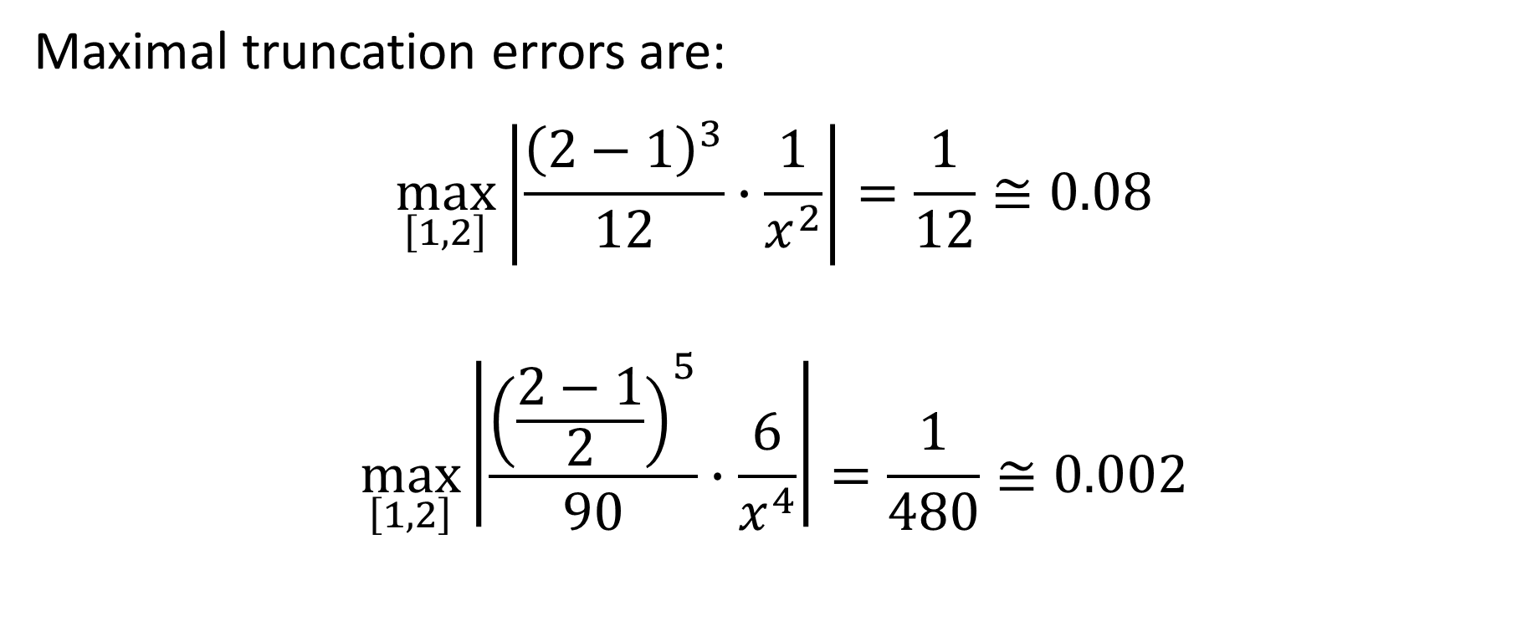
Example
Maximal truncation errors are:
$$\max_{\left[1,2\right]}\left|\frac{{\left(2−1\right)}^{3}}{12}∙\frac{1}{x^{2}}\right|=\frac{1}{12}≅0.08$$
$$\max_{\left[1,2\right]}\left|\frac{{\left(\frac{2−1}{2}\right)}^{5}}{90}∙\frac{6}{x^{4}}\right|=\frac{1}{480}≅0.002$$
Notes:
We therefore estimate the maximal truncation errors by using the error formula we presented previously and you wrote down on your paper
For the trapezoid rule, we obtain 1/12, which is about 0.08
For Simpson's rule we obtain 1/480, which is about 0.002

Slide 12
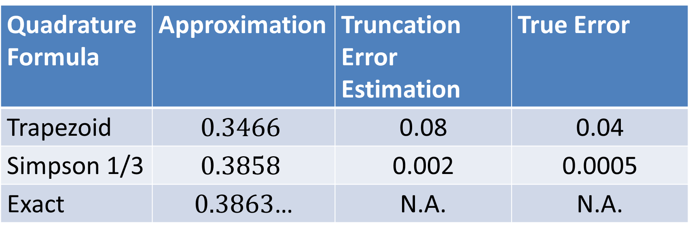
Example
Quadrature Formula | Approximation | Truncation Error Estimation | True Error
Trapezoid | $$0.3466$$ | 0.08 | 0.04
Simpson 1/3 | $$0.3858$$ | 0.002 | 0.0005
Exact | $0.3863$… | N.A. | N.A.
Notes:
We can now complete the table
Compare the estimated errors with the true errors that we can compute using the exact value of our integral
Our error estimations are conservative and overestimate the errors.
This is very good and shows that we can take benefit of them

Slide 13
Summary
The trapezoid rule is of degree of precision equal to one
The Simpson 1/3 rule is of degree of precision equal to three
Based on the error formulas one can estimate the truncation errors
Notes:
Let us summarize the key findings
- The trapezoid rule is of degree of precision equal to one
- The Simpson 1/3 rule is of degree of precision equal to three
- Based on the error formulas one can estimate the truncation errors

